Slide 1

What is an Inclusive Instant Payment System? And how do we measure its impact?
Phil Roessler
Associate Professor
Co-Director, Digital Inclusion and Governance Lab (DIGLab)
William & Mary
proessler@wm.edu

Slide 2
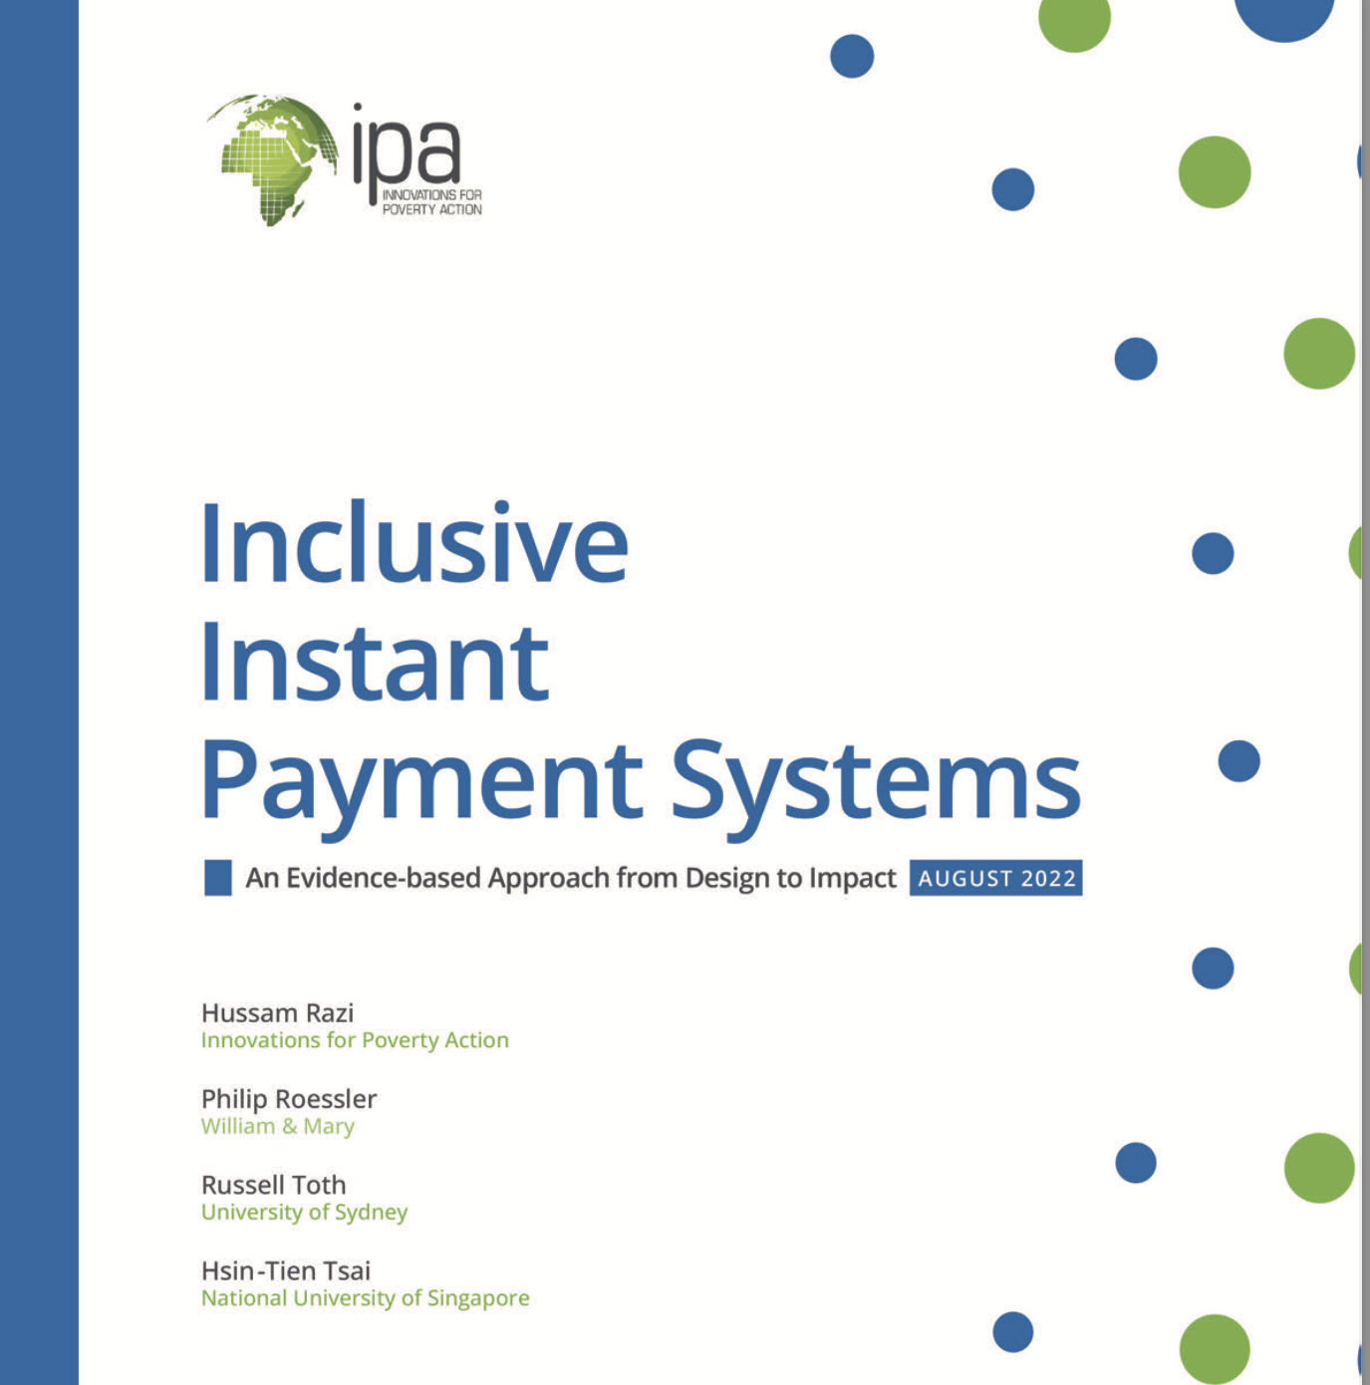
An applied economist’s toolkit to the analysis and evaluation of IIPS:
Tracing out a theory of change capturing the mechanisms of socio-economic impacts
Discussing what existing theoretical and empirical literature tells us about these mechanisms
Highlighting points of interface between academic research and policymaker priorities
Providing structured content on the empirical evaluation, and M&E, of these systems

Slide 3
Inclusive Instant Payment Systems: From Theory to Measuring Impact
What are inclusive instant payment systems—and why they matter
History: Cash as an interoperable payments’ technology—and benchmark
Theorizing and measuring the impacts of IPS
Why this is important to Mojaloop: RCTs and systematic data as diagnostic tools
What is the business impact? Credible evidence for improving and scaling

Slide 4
What are inclusive instant payment systems?
Financial systems that enable low-cost real-time payments between end-users irrespective of their financial service provider
In theory, IIPS are defined by following mutually reinforcing features—as laid out by L1P project:
Open—connect all registered FSPs
Accessible—low barriers to entry for any user
Affordable—enormous volume of low value transactions drive down fees while cover operating costs
Real-time—near-instant push payments that recipient can immediately use

Slide 5
Why inclusive instant payment systems matter?
They improve societal welfare and productivity by expanding the scope of economic exchange while reducing the enormous transaction and coordination costs that come with it.
Consider money—itself an effective interoperable technology.
It solved “the double coincidence of wants” problem that plagued barter economies, transforming the speed and scope of trade (Jevons 1876)

Slide 6
The Staying Power of Cash…and a Critical Benchmark
Interoperable: universally accepted and requires no prior relationship between buyer and seller.
Instant, or real-time: once money changes hands the recipient can reuse it immediately.
Irrevocable: once one makes a cash payment to someone else (“push” payment), it is difficult to reverse.
Low-cost: no direct transaction fees.
Accessible: requires no additional technological prerequisites.
These characteristics are critical to underpin any new payment system to rival cash and serve all users—including low-income ones.

Slide 7
Costs of Cash Drive Financial Innovation
Risky, clunky and slow for long-distance commerce
Risky and inefficient for payments at scale
Risky and costly way to save
No paper trail—good for criminals; bad for upstanding citizens
Rise of banks; savings and credit institutions; settlement banks and clearing houses; checks, credit cards, debit cards, and online banking
Modern financial system massively expands scope of exchange over long distances and incredible volumes but on the backs of an elaborate, costly, and bureaucratically-intensive infrastructure → reducing accessibility, affordability, speed, and interoperability
Gives rise to dual economy—some operating in formal financial sector and some only in cash

Slide 8
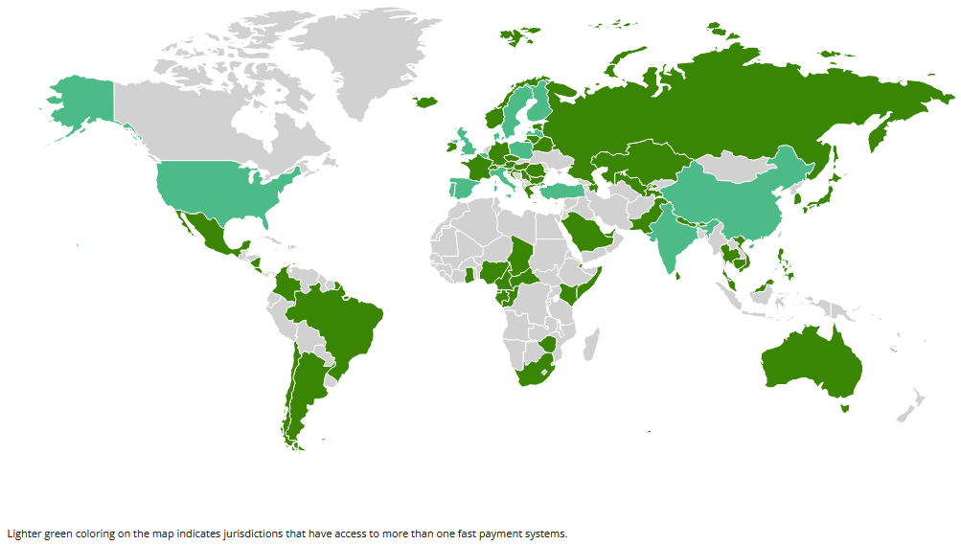
Instant, Interoperable Payment Switches are rapidly rolling out in many emerging markets. Are they bridging the dual economy?
Jordan
JoMoPay
2014
Philippines
InstaPay
2018
Mexico
CoDi
2019
Pakistan
Raast
2021
India
UPI
2016
Ghana
GIP
2012
Chile
TEF
2008
Tanzania
TIPS
2022
Myanmar
WynePay
2022-23
Brazil
PIX
2020
https://fastpayments.worldbank.org/

Slide 9
Our research program aims to quantify the impacts of IPS
Big question! How deploying new open-loop financial systems with near-instant interoperable payments functionality might transform emerging economies.
System-level change is dynamic and complex with many interconnected and moving parts.

Slide 10
Our research program aims to quantify the impacts of IPS
Big question! How deploying new open-loop financial systems with near-instant interoperable payments functionality might transform emerging economies.
System-level change is dynamic and complex with many interconnected and moving parts.
But we can’t learn if we don’t measure system-level effects. Need better and more granular data.

Slide 11
Our research program aims to quantify the impacts of IPS
Big question! How deploying new open-loop financial systems with near-instant interoperable payments functionality might transform emerging economies.
System-level change is dynamic and complex with many interconnected and moving parts.
But we can’t learn if we don’t measure system-level effects. Need better and more granular data.
Number and type of FSPs integrated in switch—and systematic assessment of who is included and excluded
Number of on-net and off-net transactions with geocoded information on type of sending and receiving FSP to better understand patterns of use
Even better would be to study this before and after launch of switch to measure the degree to which IPS is facilitating open loop and national economic integration

Slide 12
Our research program aims to quantify the impacts of IPS—Theory of Change
System-level data helps monitor important trends in financial integration but to measure impact—such as welfare effects—we need to go deeper.
To make tractable, we divide system into four constituent actors:
Financial service providers (FSPs) – institutions that manage money and offer financial services, such as savings accounts, credit, and payments
Merchants – individuals or businesses who buy and sell goods
Households/consumers – individuals who purchase goods and end-users of financial services
Government – centralized authority that enforces property rights and regulates economy to increase social welfare

Slide 13
Interoperable Payments Systems: Four Phases of Implementation
Onboarding—backend integration to the switch by FSPs.
P2P use case: off-net transfer capabilities negate need for multi-homing; alias-based payments increase speed of transactions
P2M, M2P or M2M: merchants can transact with consumers irrespective of FSP networks; supports QR code payments
G2P, P2G: and M2G: facilitates government disbursements across the universe of unique FSPs in economy; facilitates household and merchant payments to government
User integration and adoption: —consumers, merchants and government start to use switch to transact across FSP networks. Impacts structured by use case
Behavioral and organizational change—switch from cash to digital payments; merchant formalization; governments and FSPs increase digital services and products; upstream digitization of supply chains and procurement.
Dynamic market changes—↑ competition reduces payment costs, leads to innovation in products and services, new market entrants, and potential consolidation.

Slide 14
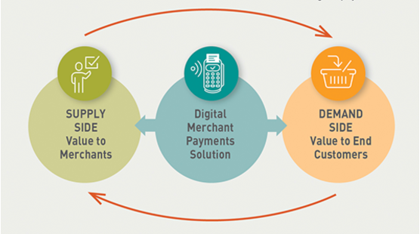
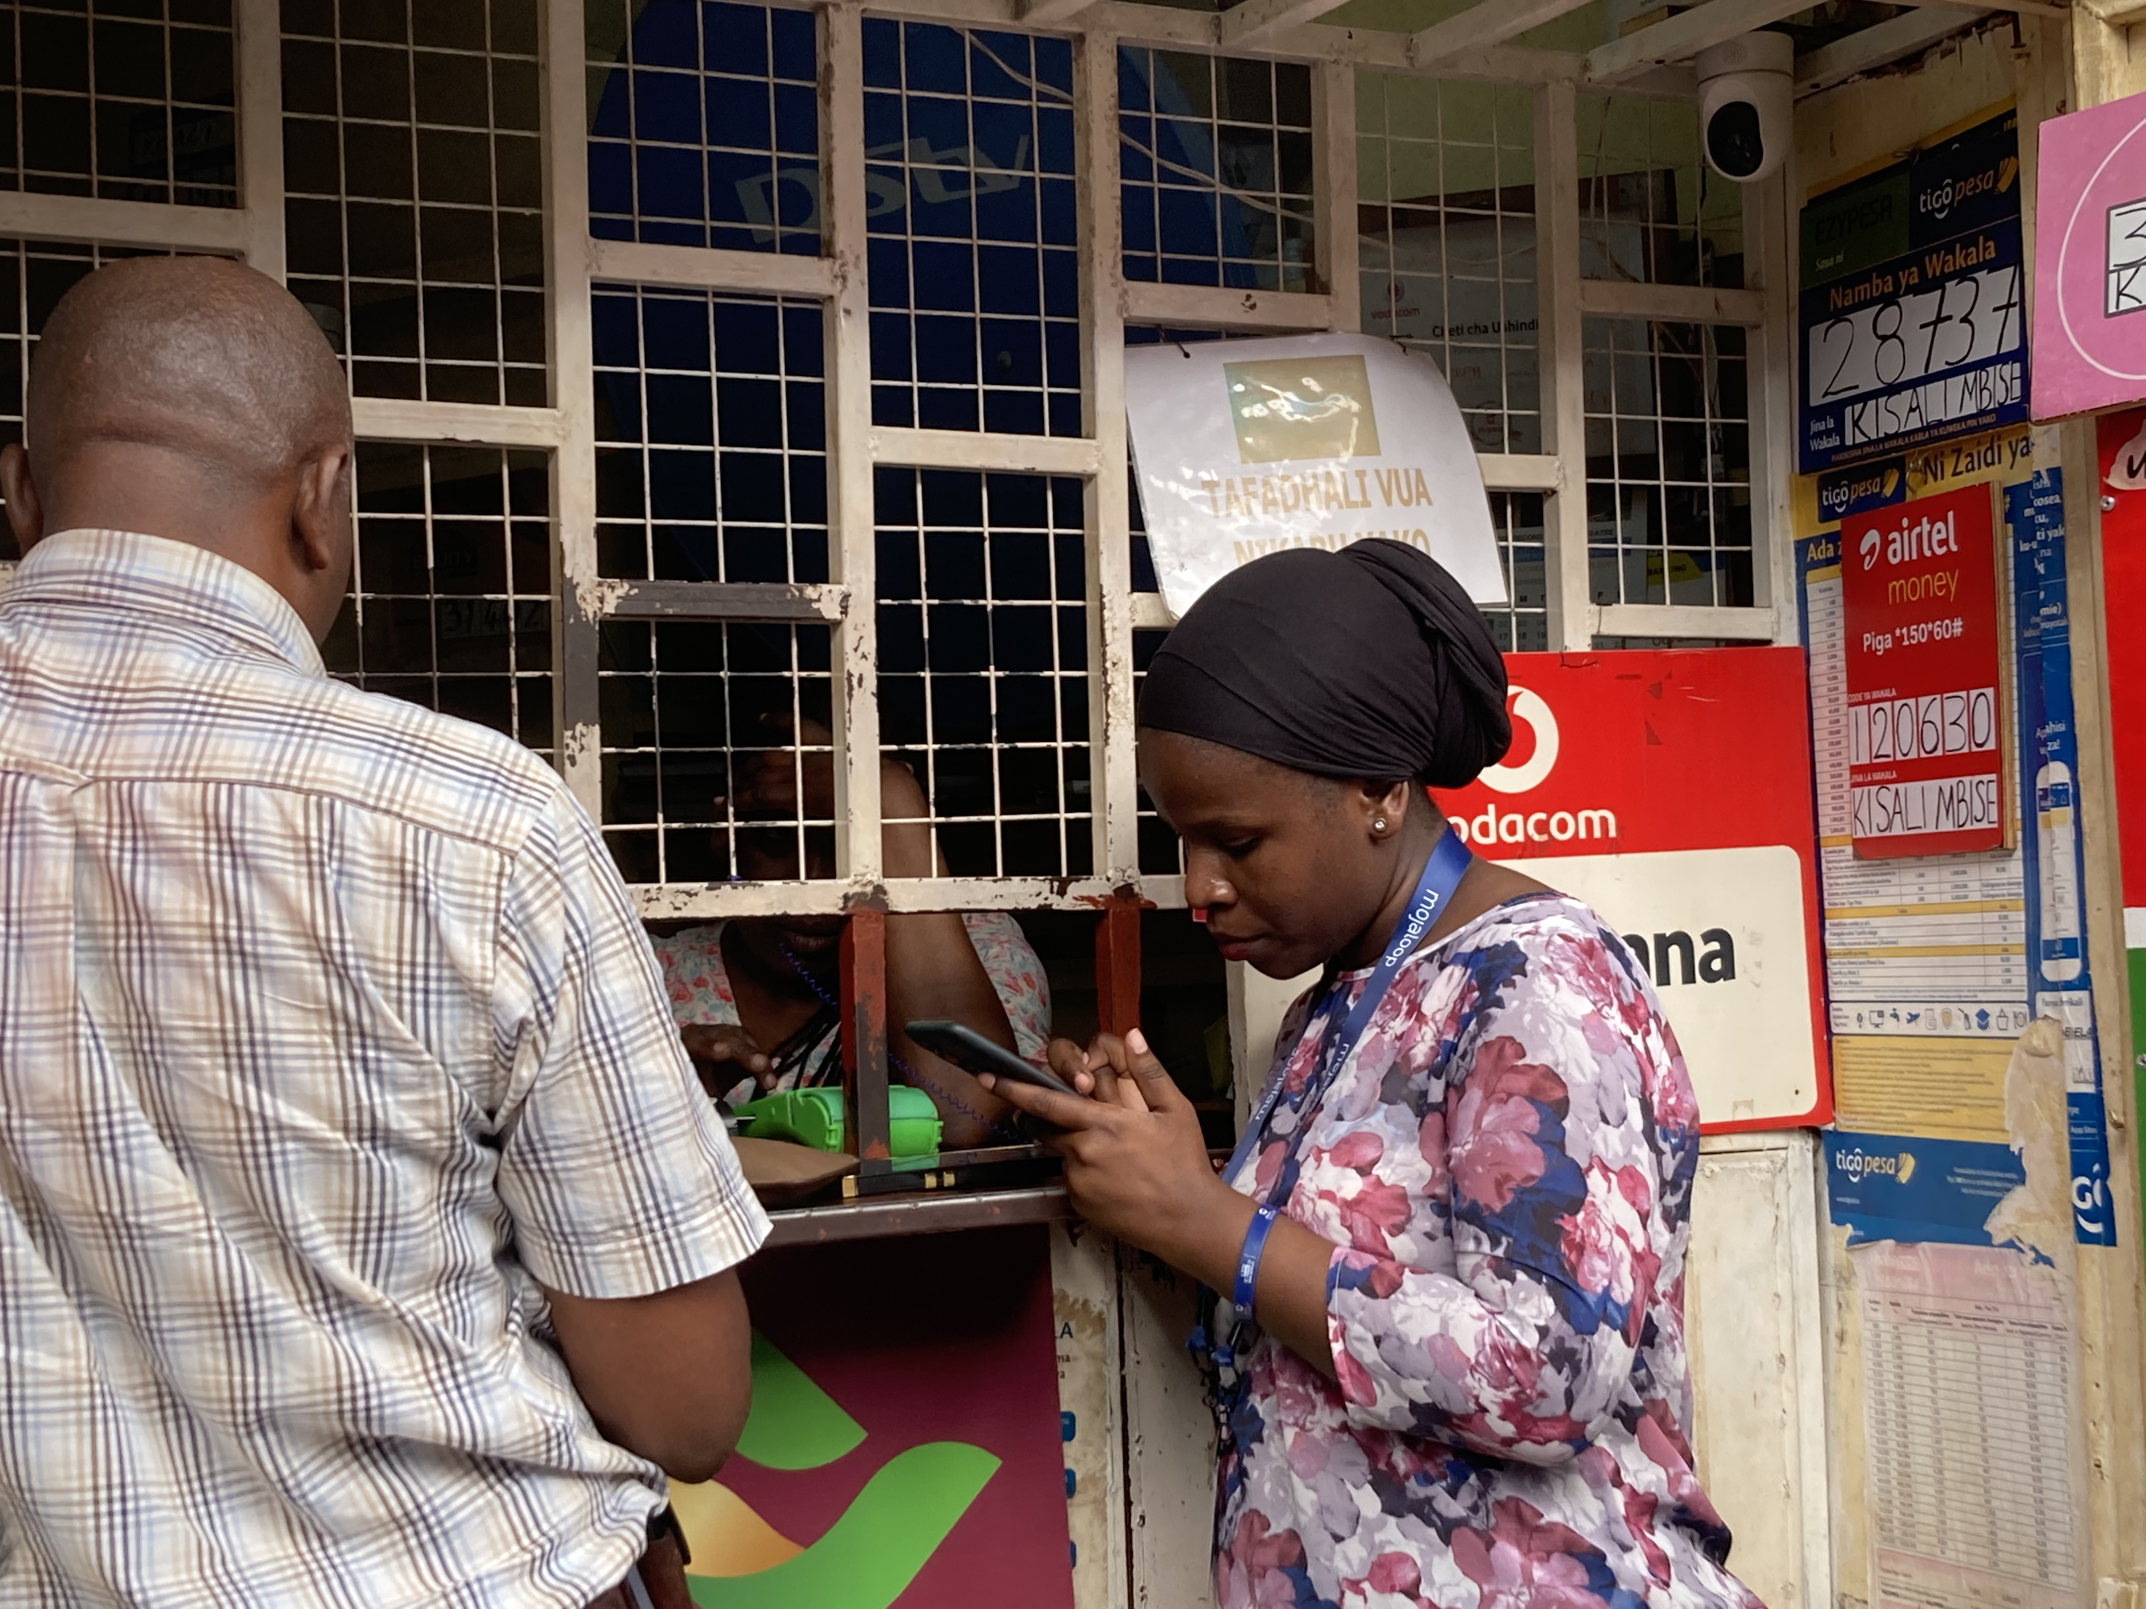
Hypothesized Impacts of Interoperable Payment Systems: Reducing Coordination and Transaction Costs
Some of the biggest gains hypothesized to come from reducing coordination and transaction costs in making payments no matter FSP network → accelerate movement away from cash in retail payments
Value for customers depends on the number of merchants who accept digital payments
Value for merchants depends on the number of customers who use digital payments
Source: CGAP, “The Challenge of Two-Sided Markets in Merchant Payments”
Jaquiline, CRDB
Network effects work against uptake of digital payments!

Slide 15
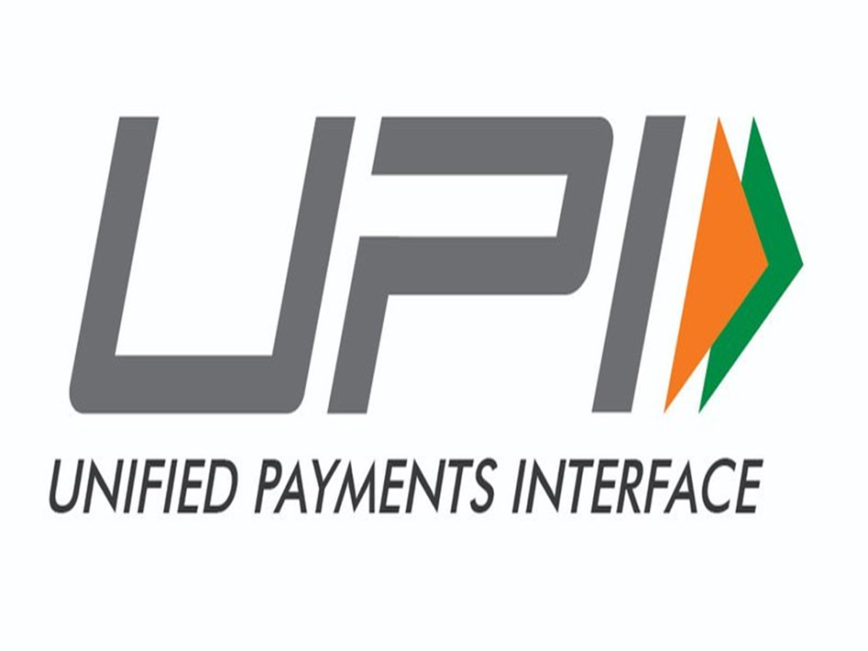
Hypothesized Impacts of Interoperable Payment Systems: Reducing Coordination and Transaction Costs
Some of the biggest gains hypothesized to come from reducing coordination and transaction costs in making payments no matter FSP network → accelerate movement away from cash in retail payments
India’s UPI paradigmatic example
Since launch of UPI, digital merchant payments have skyrocketed from virtually 0 in 2016 to 6.56 billion transactions in August 2022 with 20% P2M.
Value for customers depends on the number of merchants who accept digital payments
Value for merchants depends on the number of customers who use digital payments
Source: CGAP, “The Challenge of Two-Sided Markets in Merchant Payments”
Network effects work in favor of uptake of digital payments!

Slide 16
Hypothesized Impacts of Interoperable Payment Systems: Competition and Innovation
Interoperability empowers consumers—not locked in to transacting only with others on their FSP network
FSPs with large networks can’t simply exploit incumbency advantage to maintain market share
Enables FSPs with small networks to expand customer base by offering innovative, high-value services
Our research team is studying this in India: We anticipate interoperability to stimulate innovation (e.g., in terms of new savings, credit, insurance, or payment products) since it allows FSPs to reach a large consumer base rapidly.

Slide 17
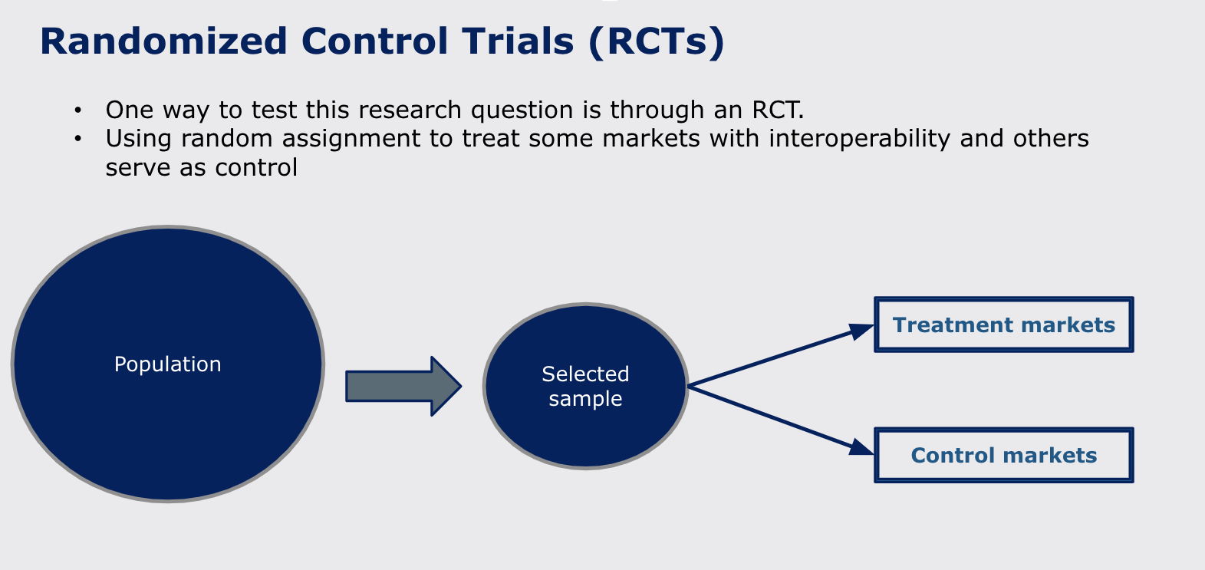
The Value of RCTs as Diagnostic, Learning and Measurement Tool
In markets with new deployment of IPS could use randomized controlled trial to test its direct impacts
Employ random assignment to select treatment and control group
On average identical, except treatment group receives intervention.

Slide 18
The Value of RCTs as Diagnostic and Learning Tool
In markets with new deployment of IPS could use randomized controlled trial to test its direct impacts
Employ random assignment to select treatment and control group
On average identical, except treatment group receives intervention.
Treatment markets: Receive marketing campaign on IPS and onboarding merchants in how to use IPS
Control markets: Receive no intervention

Slide 19
The Value of RCTs as Diagnostic and Learning Tool
RCT invaluable diagnostic and causal analysis tool
What do we learn about marketing IPS? Merchant responsiveness? Onboarding? Compliance? Consumer responsiveness?
What are effects on on-net and off-net P2P and P2M transactions?
Measure using surveys and administrative data
What are impacts on merchant profitability, consumer welfare, and market-level impact?
What are mechanisms? How much is driven by reducing coordination and transaction costs? Do we observe cross-side and same-side spillovers?

Slide 20
Asante sana!
Phil Roessler
Associate Professor
Co-Director, Digital Inclusion and Governance Lab (DIGLab)
William & Mary
proessler@wm.edu

